Slide 1

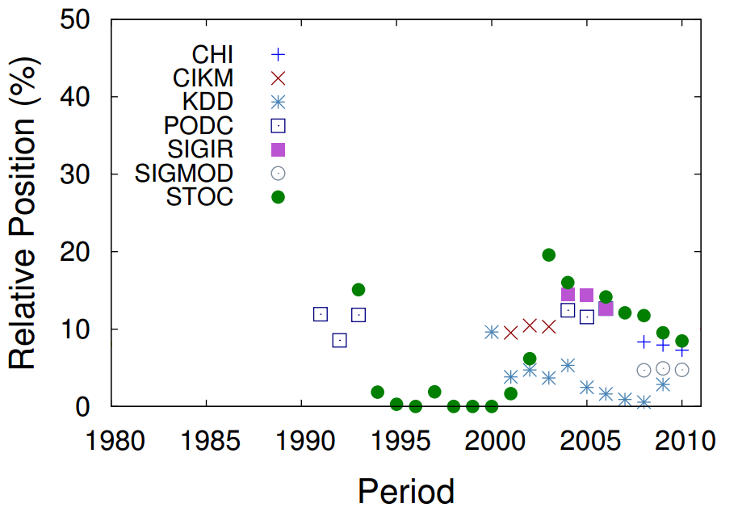
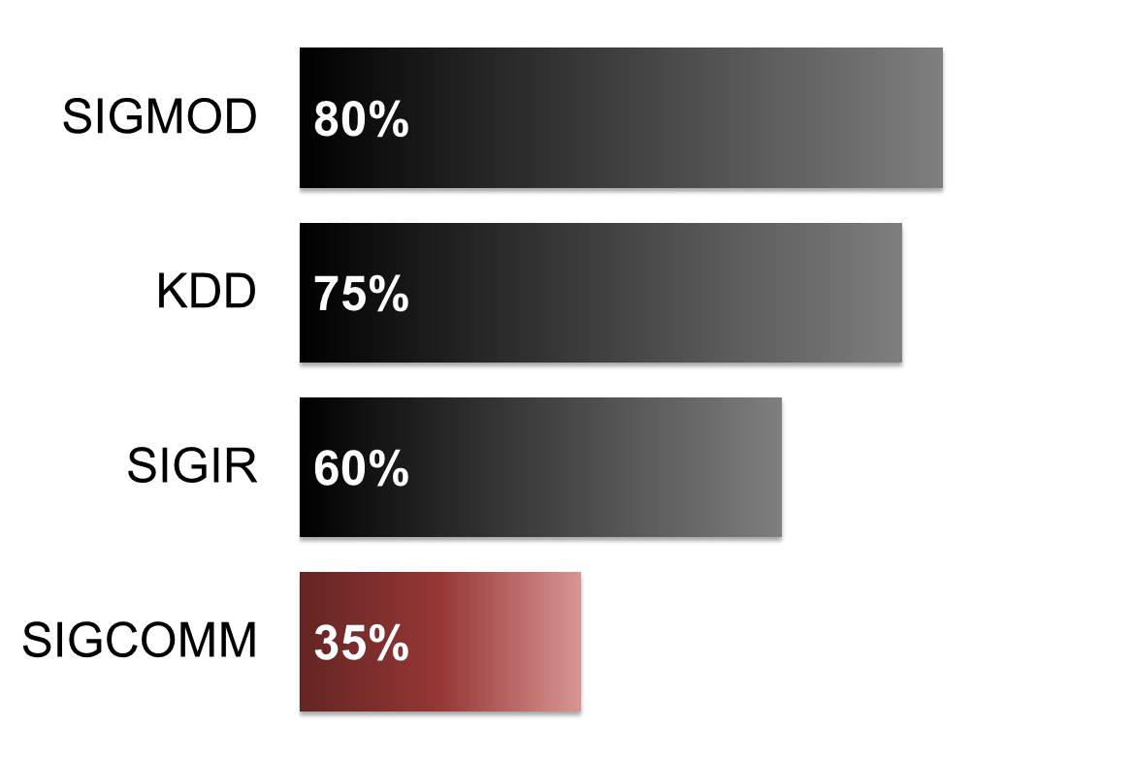
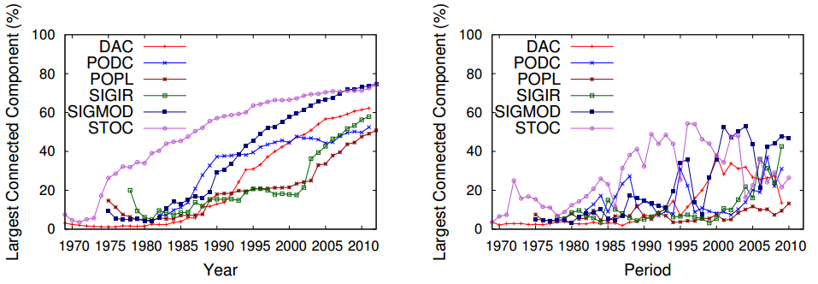
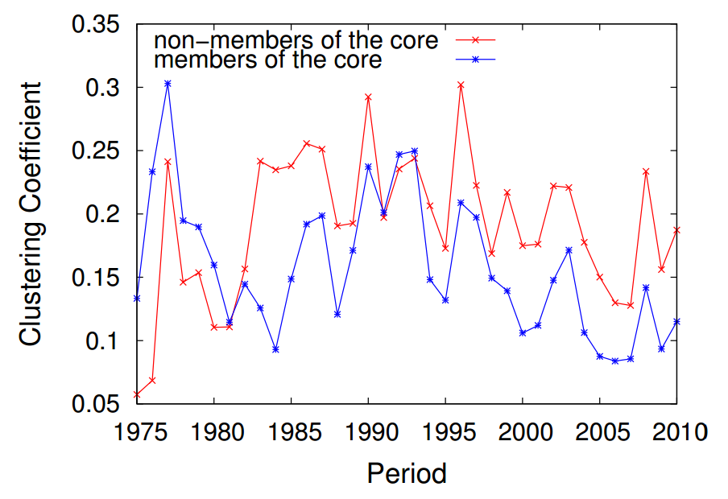
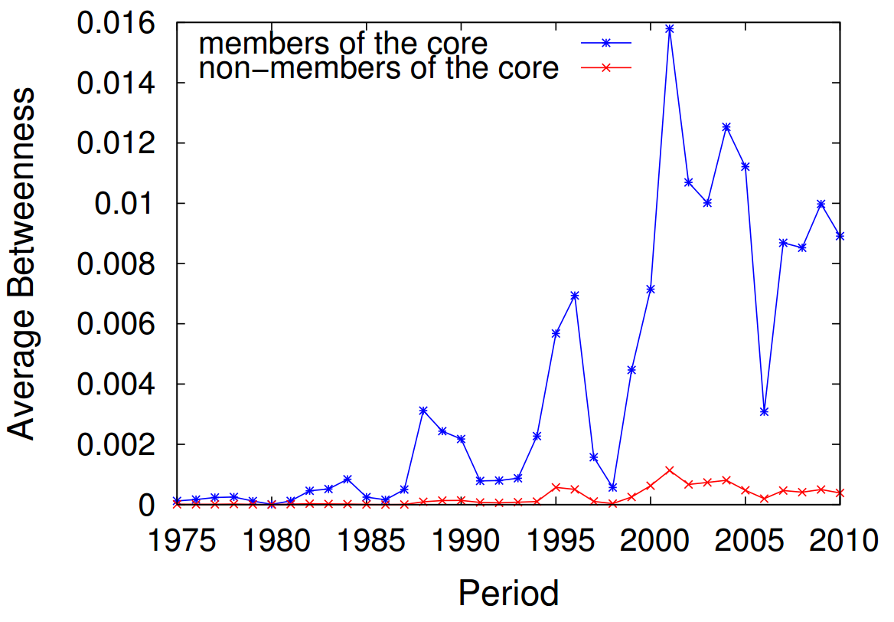
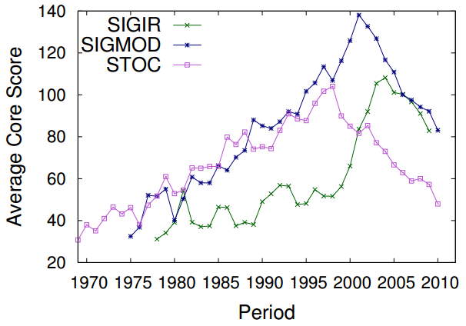


The Role of Research Leaders on the
Evolution of Scientific Communities
Bruno Leite Alves
Fabrício Benevenuto Alberto H. F. Laender
{bruno.leite,fabricio,laender}@dcc.ufmg.br
presented at #MSND@WWW2013
Abstract: In this work, we provide a wide investigation of the roles that members of the core of scientific communities play in the collaboration network structure formation and evolution. To do that, we define a community core based on an individual metric, core score, which is an h-index derived metric that captures both, the prolificness and the involvement of researchers in a community. Our results provide a number of key observations related to community formation and evolving patterns. Particularly, we show that members of the community core work as bridges that connect smaller clustered research groups. Furthermore, these members are responsible for an increase in the average degree of the whole community underlying network and a decrease on the overall network assortativeness. More important, we note that variations on the members of the community core tend to be strongly correlated with variations on these metrics.
COMMUNITY CORE
The Core Score estimates a researcher’s importance within a community. The core score of a researcher r into a community c in a period of time t is given by:
CoreScore_{r,c,t} = h_{r} × #publications_{r,c,t}
Validations
Step one: Step two:
Jon Kleinberg’s Communities
Awarded Researchers
INTRODUCTION
Since its beginning, society has been organizing itself into communities, which are groups of individuals with common interests. Communities exhibit a wide range of characteristics and serve a variety of purposes, from small groups engaged in tightly niche topics such as a very specific scientific community, to millions of users linked by an interest such as a community related to a sport team or fans of a celebrity.
Recent efforts have focused on identifying a group of influential individuals with the power to a affect not only the underlying network structure of a community, but also to interfere on the spread and flow of information within a community.
In this work, we take a different perspective and study a complementary problem. Here, we focus on studying the roles that influential individuals from a scientific community play on evolving properties of such communities.
Community Core
Three years window
PROPERTIES OF COMMUNITY CORE
Evolution of the network:
Core members act like hubs:
Three years window
SCIENTIFIC COMMUNITIES
24 flagship conferences of major ACM SIGs
We considered each conference as a scientific community
2.2 million publications from 1.2 million authors taken from DBLP
Three years window
Three years window
How the community core affect the network:
SIGACT | SIGDOC | SIGMOD
SIGAPP | SIGGRAPH | SIGOPS
SIGARCH | SIGIR | SIGPLAN
SIGBED | SIGKDD | SIGSAC
SIGCHI | SIGMETRICS | SIGSAM
SIGCOMM | SIGMICRO | SIGSOFT
SIGCSE | SIGMM | SIGUCCS
SIGDA | SIGMOBILE | SIGWEB
Average Degree
0.59
Large WCC
0.5
Average Short Path
0.49
Diameter
0.49
Three years window
-0.11
Clustering Coefficient
-0.56
Assortativity

